Slide 1
Examples
Dr. Jyotismita Chaki

Slide 2
ER Diagram: 1
Consider the following requirements list:
The airline has one or more airplanes.
An airplane has a model number, a unique registration number, and the capacity to take one or more passengers.
An airplane flight has a unique flight number, a departure airport, a destination airport, a departure date and time, and an arrival date and time.
Each flight is carried out by a single airplane.
A passenger has given names, a surname, and a unique email address.
A passenger can book a seat on a flight.

Slide 3
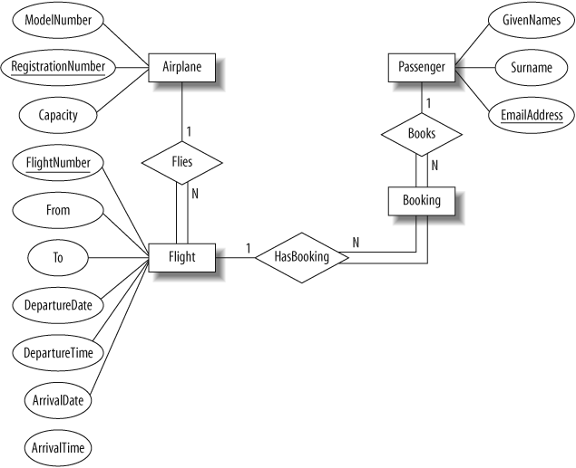
Solution

Slide 4
ER Diagram: 2
Requirements for the music database:
The collection consists of albums.
An album is made by exactly one artist.
An artist makes one or more albums.
An album contains one or more tracks
Artists, albums, and tracks each have a name.
Each track is on exactly one album.
Each track has a time length, measured in seconds.
When a track is played, the date and time the playback began (to the nearest second) should be recorded; this is used for reporting when a track was last played, as well as the number of times music by an artist, from an album, or a track has been played.

Slide 5
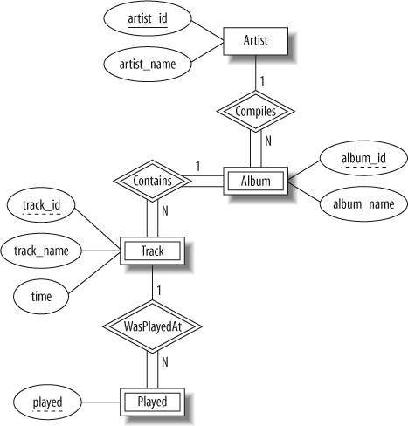
Solution

Slide 6
ER Diagram: 3
Consider the following requirements list:
The university offers one or more programs.
A program is made up of one or more courses.
A student must enroll in a program.
A student takes the courses that are part of her program.
A program has a name, a program identifier, the total credit points required to graduate, and the year it commenced.
A course has a name, a course identifier, a credit point value, and the year it commenced.
Students have one or more given names, a surname, a student identifier, a date of birth, and the year they first enrolled. We can treat all given names as a single object—for example, “John Paul.”
When a student takes a course, the year and semester he attempted it are recorded. When he finishes the course, a grade (such as A or B) and a mark (such as 60 percent) are recorded.
Each course in a program is sequenced into a year (for example, year 1) and a semester (for example, semester 1).

Slide 7
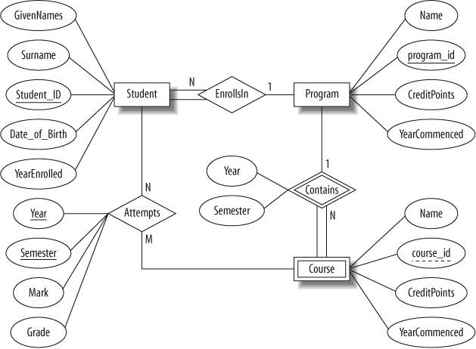
Solution

Slide 8
ER to Relational Model: 1

Slide 9
Solution
Step 1: Mapping of Regular Entity Types.
Step 1: Mapping of Week Entity Types
Airplane
RegistrationNumber | ModelNumber | Capacity
Flight
FlightNumber | From | To | DepartureDate | DepartureTime | ArrivalDate | ArrivalTime
Passenger
EmailAddress | GivenNames | Surname
Booking
EmailAddress | FlightNumber

Slide 10
Solution
Step 2: Mapping of Binary 1:N Relationship Types
Airplane
RegistrationNumber | ModelNumber | Capacity
Flight
FlightNumber | From | To | DepartureDate | DepartureTime | ArrivalDate | ArrivalTime | AirplaneRN
Passenger
EmailAddress | GivenNames | Surname
Booking
FlightNumber | EmailAddress

Slide 11
ER to Relational Model: 2

Slide 12
Solution
Step 1: Mapping of Regular Entity Types
Step 2: Mapping of Weak Entity Types
Artist
Artist_ID | Artist_Name
Album
Artist_id | Album_id | Album_name
Track
Album_id | Track_ID | Track_name | Time
Played
Track_id | Played

Slide 13
Solution
Step 2: Mapping of Binary 1:N Relationship Types
Artist
Artist_ID | Artist_Name
Album
Artist_id | Album_id | Album_name
Track
Album_id | Track_ID | Track_name | Time
Played
Track_id | Played

Slide 14
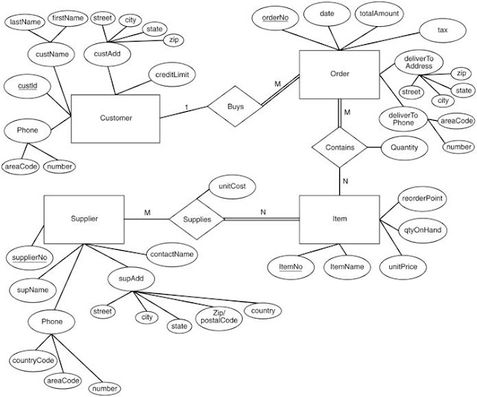
ER to Relational model: 3

Slide 15
Solution
Customer (custID, lastName, firstName, street, city, state, zip, creditLimit, areaCode, number)
Order (orderNo, date, totalAmount, tax, street, city, state, zip, areaCode, number, custId)
Supplier (supplierNo, supName, street, city, state, zip, country, contactName, countryCode, areaCode, number)
Item (ItemNo, ItemName, unitPrice, qtyOnHand, reorderPoint)
Contains (orderNo, ItemNo, Quantity)
Supplies (supplierNo, ItemNo, unitCost)

Slide 16
Normalization: 1
EID | EName | DeptID | Phone | DeptName | SkillID | SkillName | SkillYears
73775 | Alex | CU5 | 1111, 2222, 3333 | Billing | 782, 691, 783 | Cleark, Planner, Annalyst | 5, 1, 3
96347 | Bill | 41F | 4444, 5555, 6666 | Shipping | 783, 316, 780 | Analyst, Typist, Designer | 2, 2, 10
87346 | Cindy | QP2 | 7777, 8888, 9999 | Marketing | 005, 099, 316 | Sales, Secretary, Typist | 2, 15, 4

Slide 17
Solution: 1NF
EID | DeptID | EName | DeptName
73775 | CU5 | Alex | Billing
96347 | 41F | Bill | Shipping
87346 | QP2 | Cindy | Marketing
EID | DeptID | Phone | SkillID | SkillName | SkillYears
73775 | CU5 | 1111 | 782 | Cleark | 5
73775 | CU5 | 2222 | 691 | Planner | 1
73775 | CU5 | 3333 | 783 | Annalyst | 3
96347 | 41F | 4444 | 783 | Analyst | 2
96347 | 41F | 5555 | 316 | Typist | 2
96347 | 41F | 6666 | 780 | Designer | 10
87346 | QP2 | 7777 | 005 | Sales | 2
87346 | QP2 | 8888 | 099 | Secretary | 15
87346 | QP2 | 9999 | 316 | Typist | 4

Slide 18
Solution: 2NF
EID | EName
73775 | Alex
96347 | Bill
87346 | Cindy
DeptID | DeptName
CU5 | Billing
41F | Shipping
QP2 | Marketing
EID | DeptID
73775 | CU5
96347 | 41F
87346 | QP2
EID | Phone | SkillYears
73775 | 1111 | 5
73775 | 2222 | 1
73775 | 3333 | 3
96347 | 4444 | 2
96347 | 5555 | 2
96347 | 6666 | 10
87346 | 7777 | 2
87346 | 8888 | 15
87346 | 9999 | 4
SkillID | SkillName
782 | Cleark
691 | Planner
783 | Annalyst
783 | Analyst
316 | Typist
780 | Designer
005 | Sales
099 | Secretary
316 | Typist
EID | SkillID
73775 | 782
73775 | 691
73775 | 783
96347 | 783
96347 | 316
96347 | 780
87346 | 005
87346 | 099
87346 | 316

